Slide 1

Working With Data DATA9910
Week 6
Lucas Rizzo
email: lucas.rizzo@tudublin.ie

Slide 2
Indicative schedule
Week 1 | Set up environment and R notebook
Week 2 | Review Python and practice
Week 3 | Review R Importing data with R
Week 4 | Intro SQL and aggregate queries
Week 5 | Databases and scripting languages (To be submitted)
Week 6 | Interpreting Data (summary statistics, data visualisation)
Week 7 | Review week
Week 8 | Data manipulation in R Pandas and Numpy
Week 9 | Data visualisation in Python Data processing (regular expressions)
Week 10 | Audio data (R and tuneR) (To be submitted)
Week 11 | Image data (Python and skimage) (To be submitted)
Week 12 | Time series (Python and Pandas)
Week 13 | Working on Assignment Assignment deadline

Slide 3
Overview
R practice
Import data
Type conversion
Finding NAs
Calculating average and quantiles
Variation

Slide 4
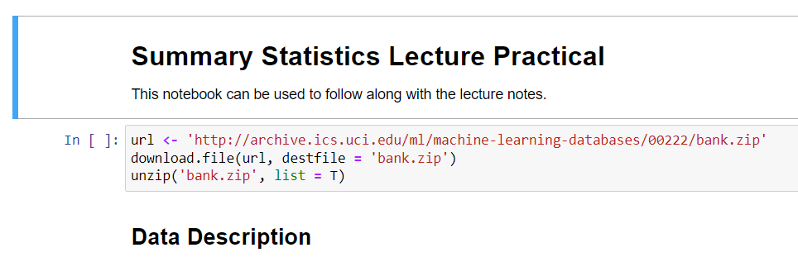
Before you start
Download the Summary Statistics Lecture Practical
Start your jupyter notebook server
Follow along with the examples in today's lecture

Slide 5
Task 1 – Import the data into R
# Download the bank.zip file from brightspace
url <- 'http://archive.ics.uci.edu/ml/machine-learning-databases/00222/bank.zip'
download.file(url, destfile = 'bank.zip')
unzip('bank.zip', list = T)
The notebook downloads and unzips the data for you
Underneath the Task 1 cell import that data into a R DataFrame
Tips in the next slide...

Slide 6
Task 1 - Tips
Check back on week 3 notes to refresh your memory
The readr package might do a better job than the base r packages
readr doesn't always guess the columns correctly
Check the docs to find out how to control the maximum number of rows readr will look at to guess a column type
If you prefer you can specify the column types yourself
Answer in the next slide...

Slide 7
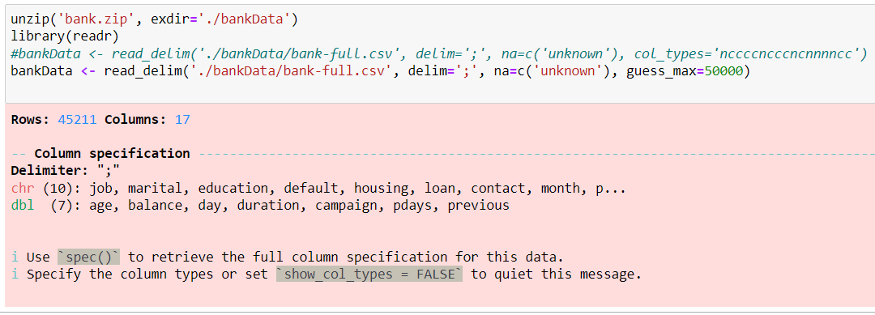
Task 1 - Answer

Slide 8
Task 2 - Basic Checks
Try this out before moving onto the next slide
Import Problems
Dataset Dimensions
Head and Tail
Answer in the next slide...

Slide 9
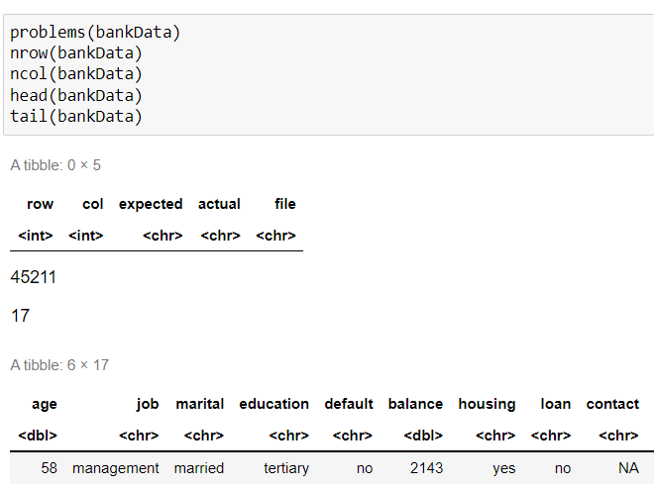
Task 2 - Answer

Slide 10
Task 3 - Type conversion
By default, the read_delim function imports strings as character type
The as.functions can be used to change the type of a column
Change the the type of the columns that should be factors
You might do that one by one or using a loop
Answer in the next slide...

Slide 11
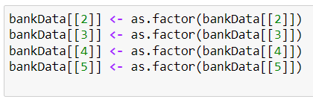
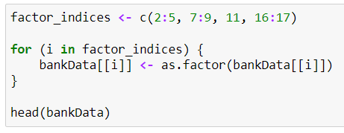
Task 3 - Answer
One by one
With a loop

Slide 12
Task 4 - Finding NAs
How many NAs are there for the education attribute?
What percentage of the total is this?
Tips in the next slide...

Slide 13
Task 4 - Tips
The is.na function takes a vector and returns a vector where the value is 1, if the input was an NA or 0 otherwise
You can calculate percentage by dividing the number of rows we're interested in by the total number of rows and multiplying by 100
Think about how you should format your data.
Answer in the next slide...

Slide 14
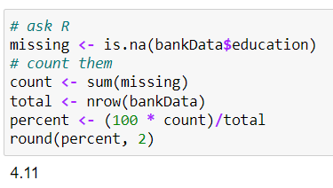
Task 4 - Answer

Slide 15
Finding NAs for all columns
We've just calculated the percentage of NAs for a single column
What if we want to do this for all columns?
Any ideas?
Answer in the next slide...

Slide 16
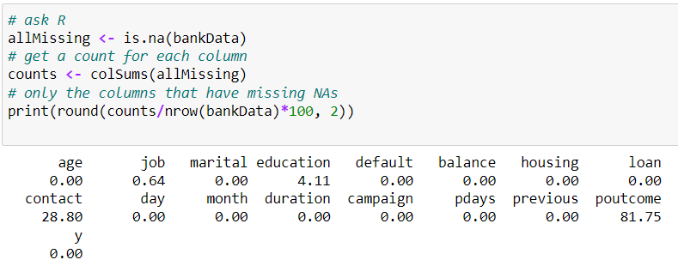
Finding NAs for all columns
We've just calculated the percentage of NAs for a single column
What if we want to do this for all columns?

Slide 17
Task 5 - Calculating Averages
What is the average value of the following columns
age
duration
pdays
Tips in the next slide...

Slide 18
Task 5 - Tips
R doesn't have an average function, it prefers the more specific term mean
Answer in the next slide...

Slide 19
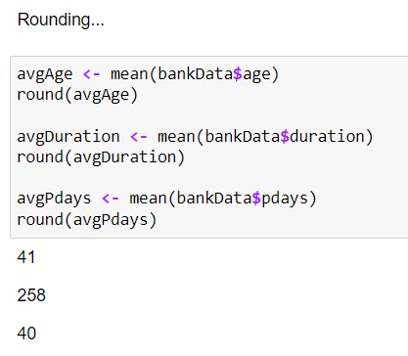
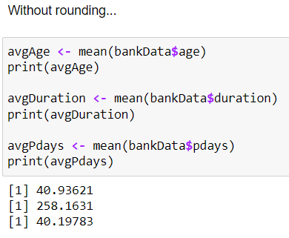
Task 5 - Answer

Slide 20
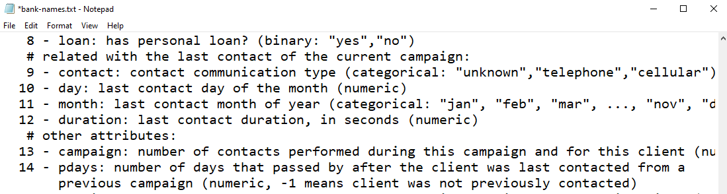
Watch Out!
It says in the data description file that:
"pdays: number of days that passed by after the client was last contacted from a previous campaign (numeric, -1 means client was not previously contacted)"
The value -1 is therefore not meaningful for calculating the average number of previous days

Slide 21
Fixing Misleading Values - NA
One option is to use NA rather than -1 to indicate that a customer wasn't contacted
We can then tell R to ignore NAs when calculating the average

Slide 22
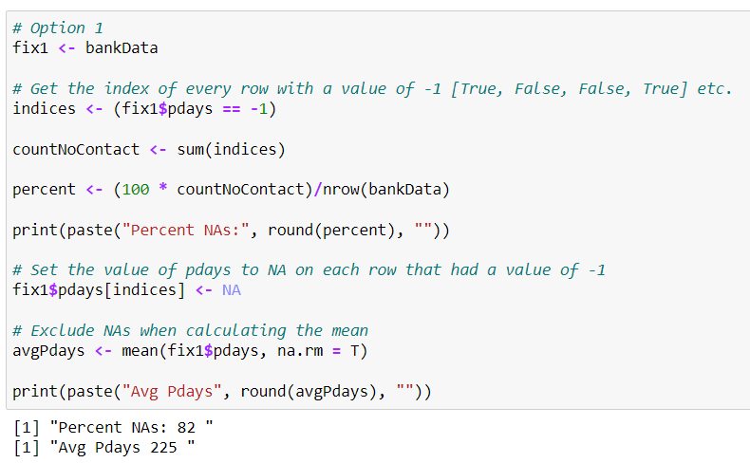
Fixing Misleading Values - NA

Slide 23
Fixing Misleading Values - Keep numeric flag
You might not want to replace the values with NA (technically the data is available and meaningful).
In this case we need to manually select the rows we want to average over

Slide 24
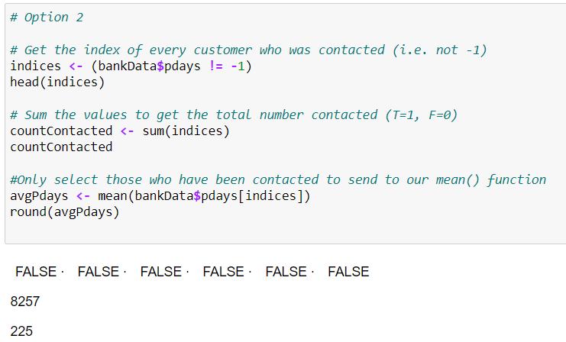
Fixing Misleading Values - Keep numeric flag

Slide 25
Task 6 - Omitting Rows Containing NA
If we wish to remove all rows containing at least 1 NA we can use the na.omit() function
This can lead to substantial data loss, so make sure you check how much you'll lose by doing this
Create a copy of the dataset omitting any rows with NAs. How much data do we lose doing this? (express as a percentage of total rows)
Tips in the next slide...

Slide 26
Task 6 - Tips
You can copy a dataframe just by assigning it to a new variable
Percentage lost = 100 – percentage remaining
Answer in the next slide...

Slide 27
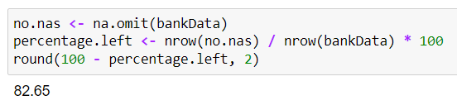
Task 6 - Answer

Slide 28
Summary Statistics
Summary statistics represent properties of the values of an attribute with a single or small set of numbers
If chosen correctly, summary statistics make it much easier to understand the shape of the data
R provides a quick summary with the summary function

Slide 29
Measures of Location
The mean and the median are the among the most commonly used summary statistics; providing a measure of location (central value) for the data
The mean is calculated by adding together the column values and dividing by the total number of values
It is not a robust tool since it is largely influenced by outliers

Slide 30
Measures of Location
The median is better suited for skewed distributions to derive at central tendency since it is much more robust and sensible.
For a sorted list of column values, the median may be calculated by
The value at the middle index if the number of values is odd {1,2,3,4,5}
Taking the average of the values at the two middle indices if the number of values is even {1,2,3,4,5,6}

Slide 31
Percentile
For ordered data, the percentile is a useful summary statistic
The P-th percentile or quantile (0 <= P <= 100) of a list of values sorted in ascending order is given as:
The smallest value, such that at least P percent of the data is less than or equal to that value

Slide 32
Task 7 - Calculating Quantiles
Write a script to find the tenth percentile of the following data. c(14, 15, 9, 14, 8, 9, 6, 7, 8, 12) Use the first cell to add your own implementation.
Now find the 30th, 50th and 75th percentile
In the second cell, use the r quantile() function to calculate each of the percentiles above
Tips in the next slide...

Slide 33
Task 7 - Tips
Begin by working out which index you need from the list
In a list of 100 items the 50th percentile is the value in position 50
Remember that we can't use doubles to index a list, make sure you get your desired index as an int
Use ?quantile to find out more about the R quantile function
Answer in the next slide...

Slide 34
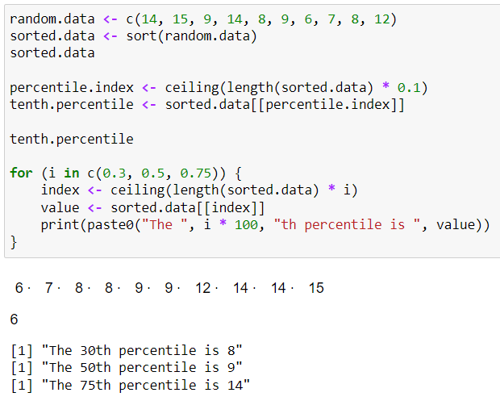
Task 7 - Answer

Slide 35
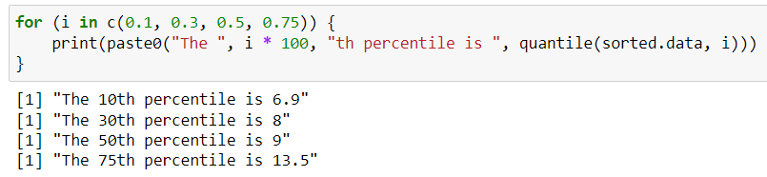
Task 7 - Answer

Slide 36
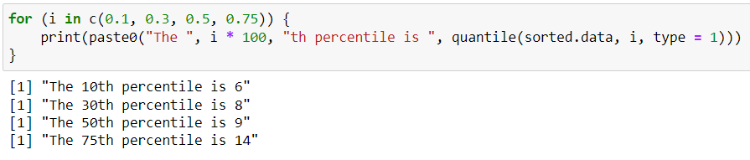
Quantiles and Interpolation
Notice that R gave slightly different answers to the ones we got.
Quantiles may use linear interpolation to smooth the values. For instance when quantiles fall in decimal positions.
Linear interpolation is a method of curve fitting.
The type parameter of the quantile function allows you to change how R deals with it (documentation is a bit confusing…)

Slide 37
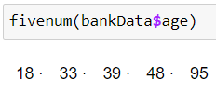
The Five Number Summary
The fivenum function returns a selection of five percentile values i.e. 0%, 25%, 50%, 75% and 100%

Slide 38
Trimmed mean
Technically, the mean only gives a measure of the central value if the distribution is symmetric
The trimmed mean can be used to mitigate the effect of outliers i.e. for a value of trim T (0 <= T <= 0.5), the top and bottom Tx100 percent of the data are excluded from the calculation.
For example: T = 0.01 excludes top and bottom 1%

Slide 39
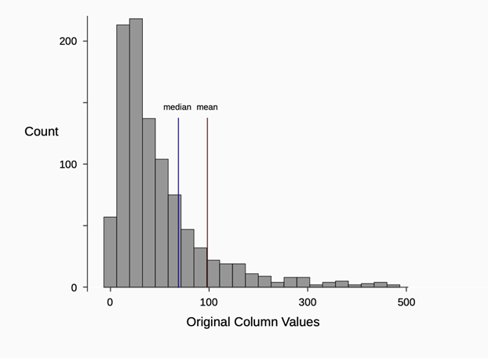
Skewed data

Slide 40
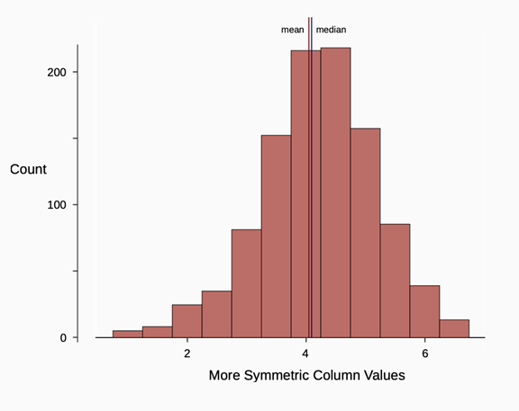
Roughly Symmetric Data

Slide 41
Task 8 - Calculate the Trimmed Mean
Calculate the mean and median of the balance feature of our bankData dataframe
Calculate the trimmed mean @ T = 0.1
Show that the trimmed mean is more representative of the centre than the raw mean
Tips in the next slide...

Slide 42
Task 8 - Tips
We can use quantiles to find cut-off points for the top or bottom x% of values
Logical subsetting (indexing) can help us select only the rows we're interested in
Have a look at the graphs on the previous slides showing skewed and symmetric data, this should give a hint as to how you can show which is more representative
Answer in the next slide...

Slide 43
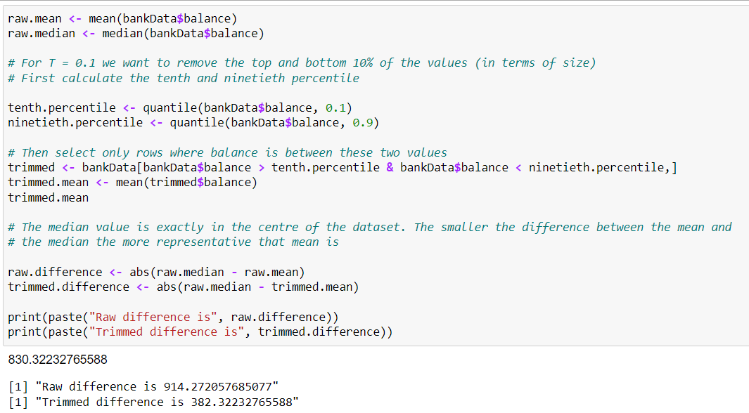
Task 8 - Answer

Slide 44
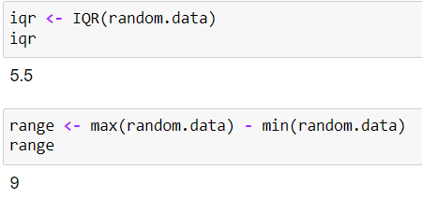
Measures of Spread
Measures of spread are summary statistics that capture the separation of the data about the central value
The range and the interquartile range (IQR) measures are similar in that they estimate the spread of a column of values by subtracting extreme values
IQR(x) = quantile(x, 3/4) - quantile(x, 1/4)
range = max(x) - min(x)

Slide 45
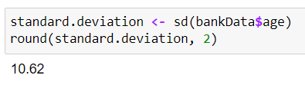

Measures of Spread
The standard deviation is a measure of the average distance of each column value from the mean:
The variance is simply the square of the standard deviation

Slide 46
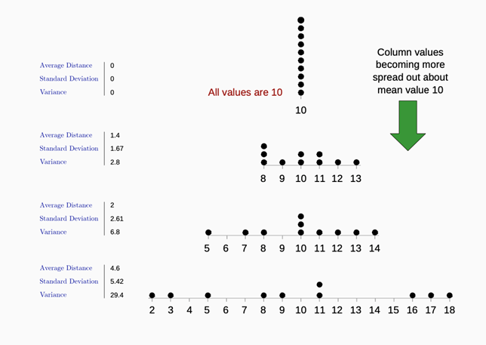
Measures of Spread

Slide 47
Summary
Data Sanity Checks
The importance of fixing magic numbers or numeric flags
Measures of Location: mean, median, percentile
Measures of Spread: interquartile range, standard deviation, variance

Slide 48
Questions?

